Slide 1

TUTORIAL TIME-SYNCHRONIZED STATE ESTIMATION IN MICRO-PMU UNOBSERVABLE DISTRIBUTION SYSTEMS
Anamitra Pal
May 2024

Slide 2
Content
Introduction
Bayesian estimation
Sensor placement as a feature selection problem
Deep learning-based distribution system state estimation (DNN-based DSSE)
Data generation – MATLAB-OpenDSS
DNN training – Python-Keras
Results

Slide 3
Introduction
Why do we need to do DSSE based on µPMU measurements?
System states are varying more frequently due to increasing penetration of distributed energy resources
Why do we need to do μPMU placement for incompletely observed systems?
It is economically not viable to have complete observability by μPMUs. DNN-based DSSE is proposed as a strategy to overcome the unobservability problem

Slide 4
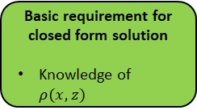
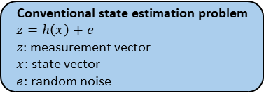
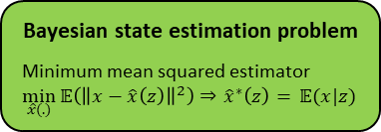


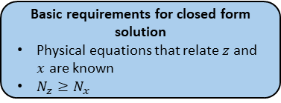
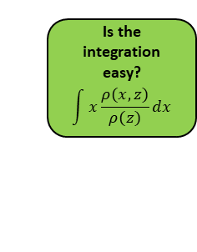
Bayesian State Estimation
Estimation in presence of severe rank deficiency
Conventional state estimation problem
$$z=h\left(x\right)+e$$
$z$: measurement vector
$x$: state vector
$e$: random noise
Basic requirements for closed form solution
Physical equations that relate $z$ and $x$ are known
$N_{z}≥N_{x}$
Closed form solution!
What if $N_{x}≫N_{z}$ ?
Let us treat $z$ and $x$ as random variables
Closed form solution!
Is the integration easy?
$$\int{x\frac{ρ(x,z)}{ρ(z)}}dx$$
Yes
Bayesian state estimation problem
Minimum mean squared estimator
$$\min_{\hat{x}(.)}{𝔼\left({\left\|x−\hat{x}\left(z\right)\right\|}^{2}\right)⇒{\hat{x}}^{∗}\left(z\right)=} 𝔼(x|z)$$
Basic requirement for closed form solution
Knowledge of $ρ(x,z)$
Yes
No
No
Deep learning!

Slide 5
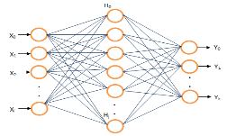
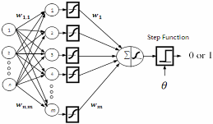
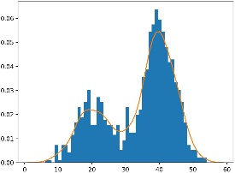






Online Implementation
Distribution Learning from Load Data
$$y$$
Trained DNN-SE
Slow Timescale Data
Real-Time PMU/micro-PMU Measurements
$$z$$
$$\hat{x}\left(z\right)$$
Distribution Estimate
$$\hat{s}(z)$$
State Estimates
$$F_{s}$$
Topology Estimates
Trained DNN-TI
PMU/micro-PMU Placement
DNN-TI for Topology Identification (Classification)
Monte Carlo Sampling
Training Data Generation
$$\left(x,s,z\right)$$
Injection samples
Power flow
Measurement Noise Addition
Training samples
DNN-SE for State Estimation (Regression)
Offline Learning

Slide 6
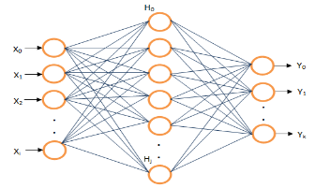
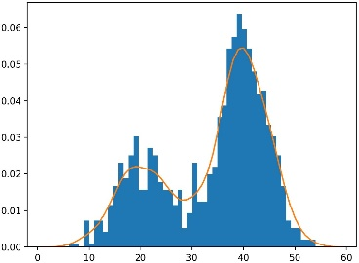





Online Implementation
Distribution Learning from Load Data
$$y$$
Trained DNN-SE
Slow Timescale Data
$$z$$
Real-Time µPMU Measurements
$$\hat{x}\left(z\right)$$
Distribution Estimate
State Estimates
$$F_{s}$$
µPMU placement
DNN-SE for State Estimation (Regression)
Monte Carlo Sampling
Training Data Generation
$$\left(x,z\right)$$
Injection samples
Power flow
Measurement Noise Addition
Training samples
Offline Learning

Slide 7

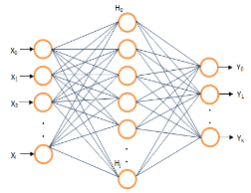
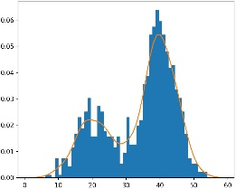



Schematic of the Proposed Method
Slow time scale historical smart meter measurements
Online Implementation
$$z$$
Trained DNN-SE
No
Is the number of samples enough?
Real-Time PMU/micro-PMU Measurements
Yes
$$\hat{x}\left(z\right)$$
State Estimates
Distribution Learning from load/generation data
PMU/micro-PMU Placement
$$\left(x,z\right)$$
DNN-SE for State Estimation (Regression)
Fitted distribution using KDE
Training Data Generation
Monte Carlo Sampling
load/generation samples
Power flow
Measurement Noise Addition
Offline Learning

Slide 8
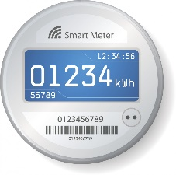
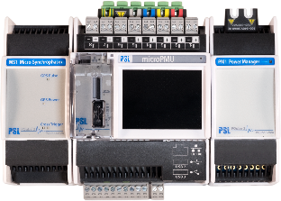

Different Time Resolution
Smart Meter
µPMU
15-minute average power (kw)
measurements are not available in real-time
120 samples/second voltage phasor
real-time measurements
Smart meter data is only used to generate sample voltage phasors to train neural network (Offline operation)
Real-time µPMU measurements is used in testing stage (Online operation)
Can we use Kernel Density Estimation (KDE) to create high resolution power injection samples from historical smart meter data
Two-sample Kolmogorov–Smirnov test
Shape
Mann Whitney U Test
Median

Slide 9
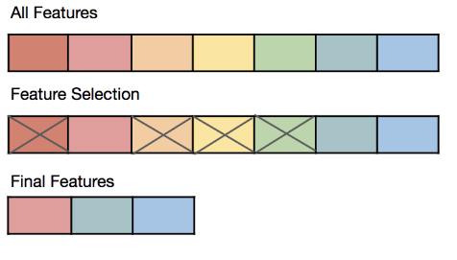
µPMU Placement for Incompletely Observed Networks
Feature Selection
Used for DNN
Finds the minimum number of required µPMUs for incompletely observed networks
Integrated µPMU Placement
Spearman’s Correlation Coefficient
DNN based DSSE
Numerical input Numerical output
Regression

Slide 10
DNN Training
Dropout
Batch normalization
# of layers
Batch size
DNN Training
# of neurons
Optimizer
Activation function
Learning rate
Reduce on plateau
Loss function
Grid search
Sensitivity analysis

Slide 11
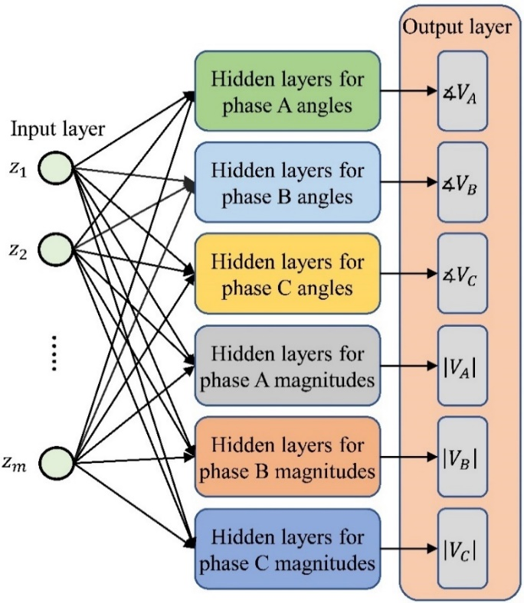
DNN Training
DNN-based DSSE for unbalanced three phase systems with interphase correlations

Slide 12
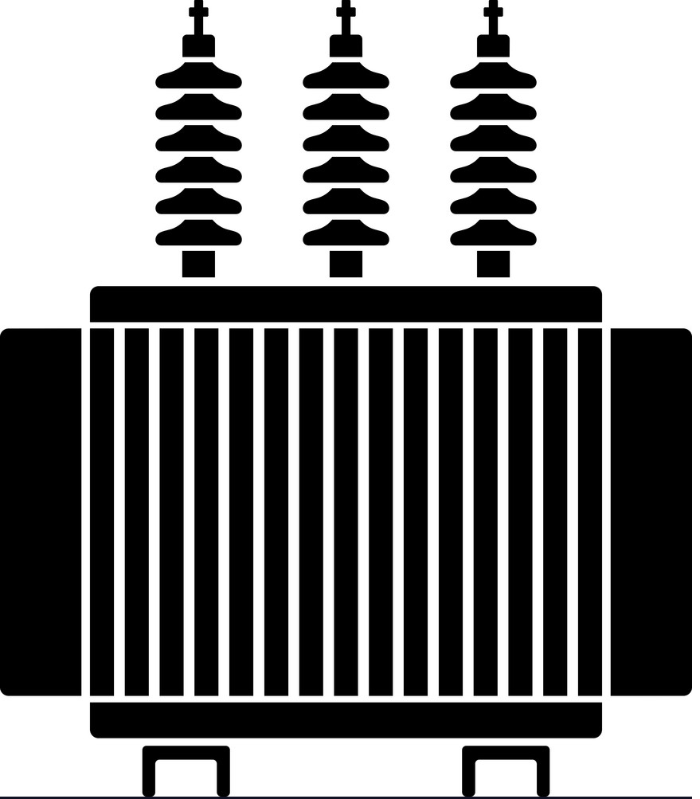
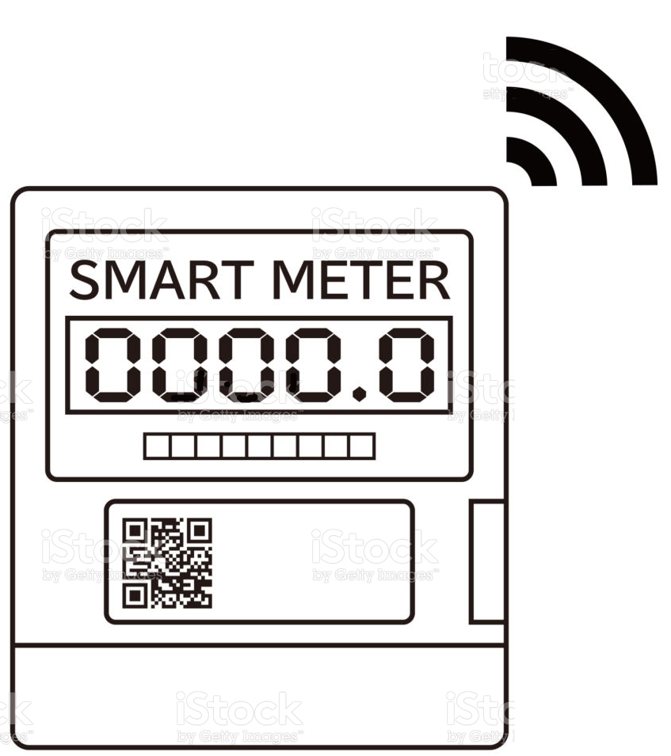
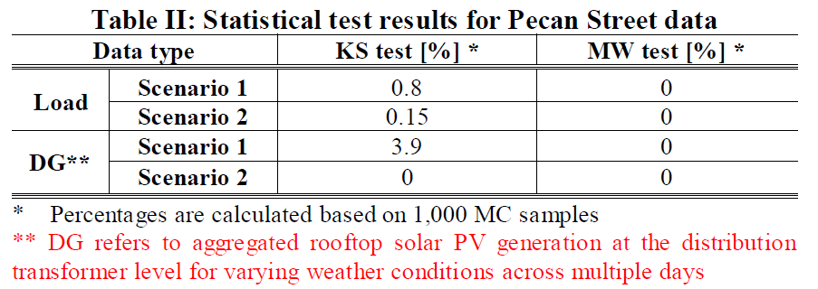
Creating High Resolution Load Profiles for Primary Network
10,000 Monte Carlo runs for different combinations of loads (25 loads are available from Pecan street data)
6-8 loads to each transformer

Slide 13
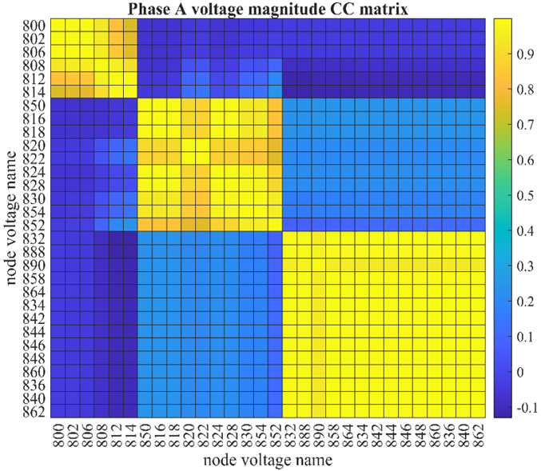
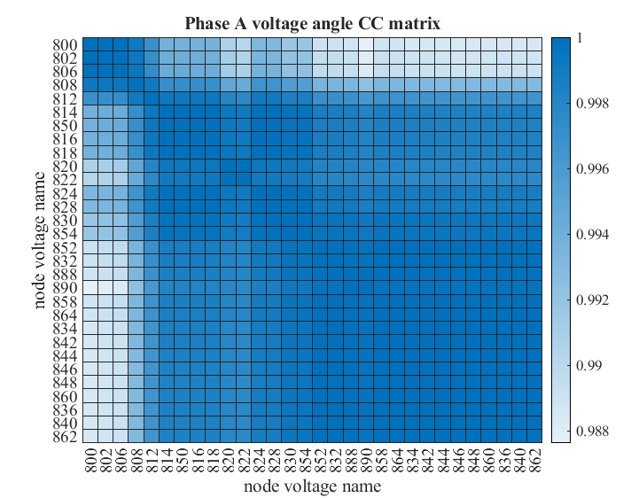
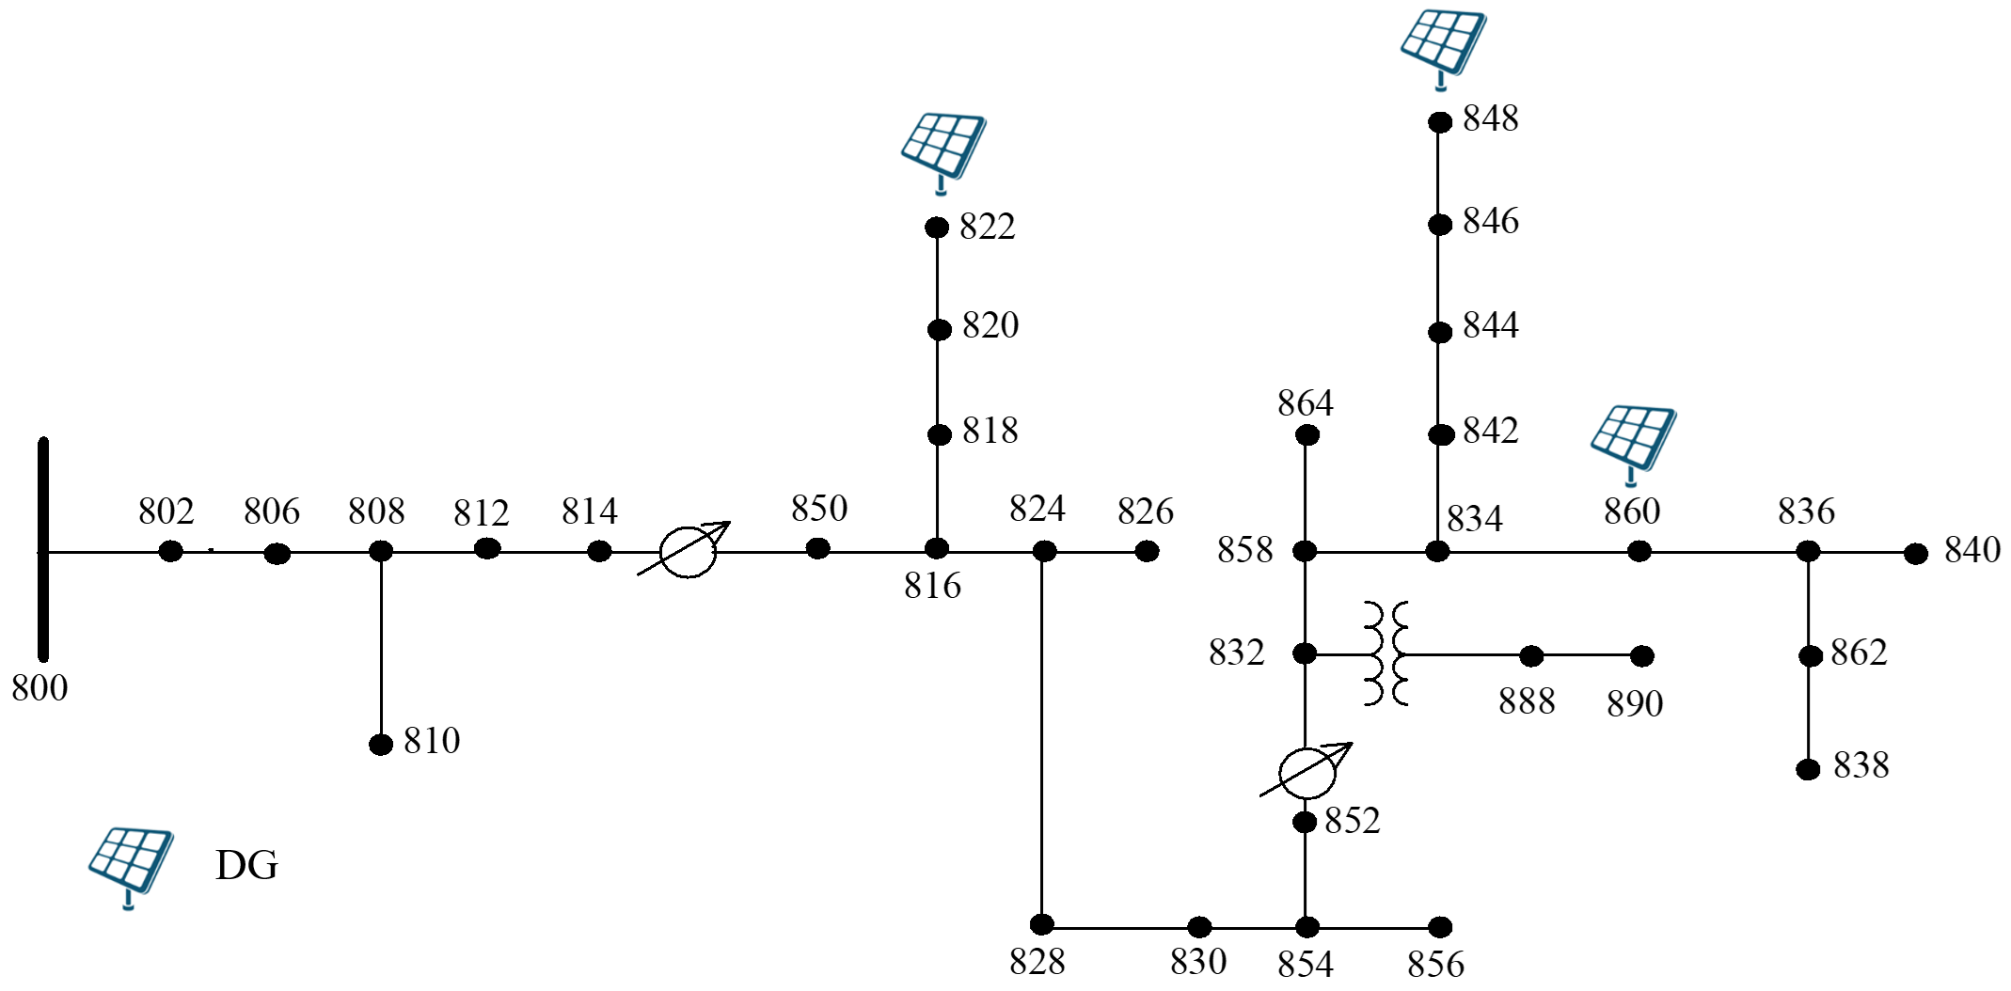
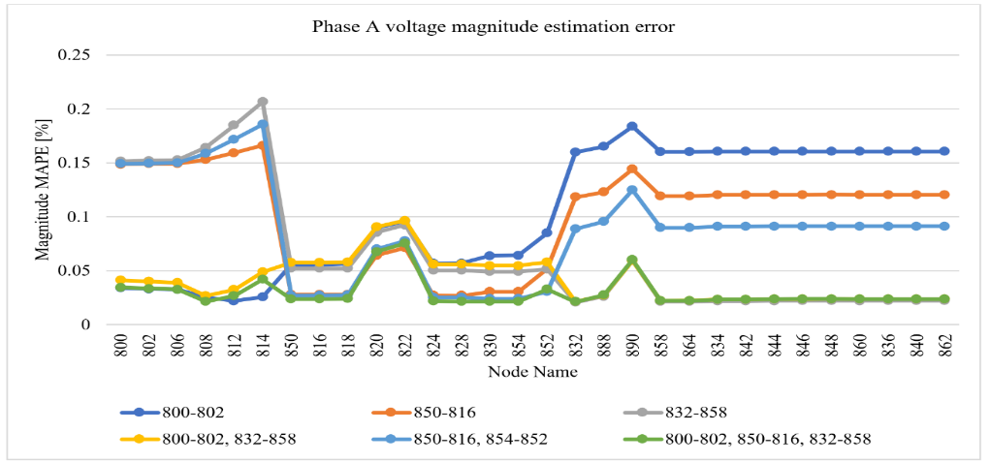
IEEE 34-Node System

Slide 14
Summary
Historical energy readings can be used to generate instantaneous high speed power injections for scenario generation using KDE
µPMU placement ensures acceptable accuracy for DNN-based DSSE

Slide 15
Publications
Journal
B. Azimian, R. S. Biswas, S. Moshtagh, A. Pal, L. Tong and G. Dasarathy, "State and Topology Estimation for Unobservable Distribution Systems Using Deep Neural Networks," in IEEE Transactions on Instrumentation and Measurement, vol. 71, pp. 1-14.
B. Azimian, S. Moshtagh, A. Pal and S. Ma, "Analytical Verification of Performance of Deep Neural Network Based Time-Synchronized Distribution System State Estimation," in Journal of Modern Power Systems and Clean Energy.
A. C. Varghese, H. Shah, B. Azimian, A. Pal and E. Farantatos, "Deep Neural Network-Based State Estimator for Transmission System Considering Practical Implementation Challenges," in Journal of Modern Power Systems and Clean Energy.
Conference
R. S. Biswas, B. Azimian and A. Pal, "A Micro-PMU Placement Scheme for Distribution Systems Considering Practical Constraints," 2020 IEEE Power & Energy Society General Meeting (PESGM), Montreal, QC, Canada, 2020, pp. 1-5.
B. Azimian, R. S. Biswas, A. Pal and L. Tong, "Time Synchronized State Estimation for Incompletely Observed Distribution Systems Using Deep Learning Considering Realistic Measurement Noise," 2021 IEEE Power & Energy Society General Meeting (PESGM), Washington, DC, USA, 2021, pp. 1-5.
B. Azimian, A. Pal, B. Abu-Jaradeh, L. Chen and P. Markham, "PMU-Timescale Topology Identification of Sub-station Node-Breaker Models using Deep Learning," 2023 IEEE Power & Energy Society General Meeting (PESGM), Orlando, FL, USA, 2023, pp. 1-5.
S. Moshtagh, A. I. Sifat, B. Azimian and A. Pal, "Time-Synchronized State Estimation Using Graph Neural Networks in Presence of Topology Changes," 2023 North American Power Symposium (NAPS), Asheville, NC, USA, 2023, pp. 1-6.
Book Chapter
B. Azimian, R. S. Biswas, and A. Pal, “Application of AI and machine learning algorithms in power system state estimation.” in “Cyber-physical power systems: challenges and solutions by AI/ML, big data, blockchain, IoT, and information theory paradigms”, Wiley-IEEE Press, Ch. 23, 2023.

Slide 16
Thank you!

